Slide 1
Experiences and perspectives on access to medical devices, including challenges related to affordability, availability, and quality
Kai Rüenbrink
MEP Heartgroup Meeting 2023

Slide 2
?
?
?
EU-Medical Device Regulation
?
?
Kai Rüenbrink
MEP Heartgroup Meeting 2023

Slide 3
history of the EU-MDR
1990: first laws for active implantable medical devices in Europe
1993: laws concerning general medical devices
…..
2017: EU-MDR comes into force
2021: 26th of May, beginning of validity
2024: 26th of May, end of transitional provision
….
Kai Rüenbrink
MEP Heartgroup Meeting 2023

Slide 4
Why was the EU-MDR introduced?
The EU-directives before the EU-MDR as a regulation “light
➔ device failures (e. g. “breast implants scandal”)
➔ uncomplicated
The new regulation (EU 745/2017)
➔ high level of health protection
➔ smooth functioning of the internal market
That was the idea behind the EU-MDR……..but….
Kai Rüenbrink
MEP Heartgroup Meeting 2023

Slide 5
the consequences
More and more medical devices are disappearing from the market, especially products for the treatment of rare diseases or products for children
(“orphan-devices”)
…….
Kai Rüenbrink
MEP Heartgroup Meeting 2023

Slide 6
the reasons
approximately 34.000 medical device manufacturers in Europe
about 95% small and medium-sized enterprises.
Companies which develop new products
➔ often small businesses with only a few experts
in regulatory affairs.
➔ This makes the burden of compliance more difficult to manage than it would be in a larger organization.
➔ not an initial exercise, it requires ongoing maintenance and resources from the manufacturer
Costs and duration of assessment
Kai Rüenbrink
MEP Heartgroup Meeting 2023

Slide 7
comparison
Europe and North America
 | EU MDR 2017/745 | US FDA | Health Canada
Costs of assessment | € 135.844 ($ 142.832) every 5 Years | € 3.030 ($ 3.186) one payment (small business fee) | € 7.412 ($9.964 CAD) + annual license renewal cost of € 283
Duration of assessment | 18-24 month review time | 30-day review | License amendment review, received within 47 days
Comparison of costs and duration of regulatory assessment in Europe and North America, for the Z-5 and Z-6 Atrioseptostomy cathetersmanufactured by NuMed
Kai Rüenbrink
MEP Heartgroup Meeting 2023

Slide 8
the consequences II
More and more medical devices are disappearing from the market, especially products for the treatment of rare diseases or products for children
(“orphan-devices”)
…….
And once products have disappeared from the market, it is almost impossible to reintroduce them in a timely manner.
Kai Rüenbrink
MEP Heartgroup Meeting 2023

Slide 9
the consequences III
The Rashkind Balloon Catheter
1966: William Rashkind developed balloon atrial septostomy
➔ well-established
➔ potentially life-saving intervention for cyanotic CHD
➔ for neonates or young infants.
Three years ago were three alternative devices available.
Now only one remains available in Europe.
Kai Rüenbrink
MEP Heartgroup Meeting 2023

Slide 10
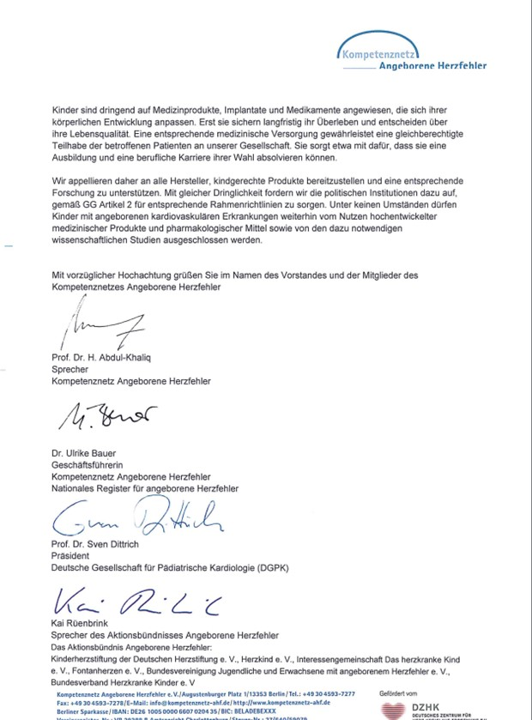
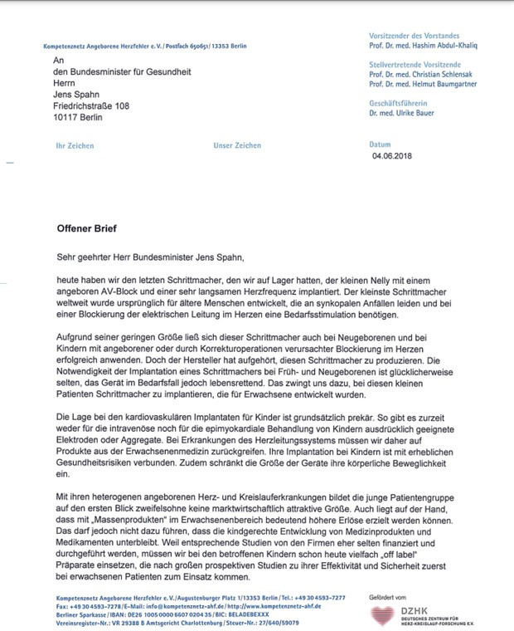
our activities
2018
Kai Rüenbrink

Slide 11
our activities II
Did we get an answer?
Kai Rüenbrink
MEP Heartgroup Meeting 2023

Slide 12
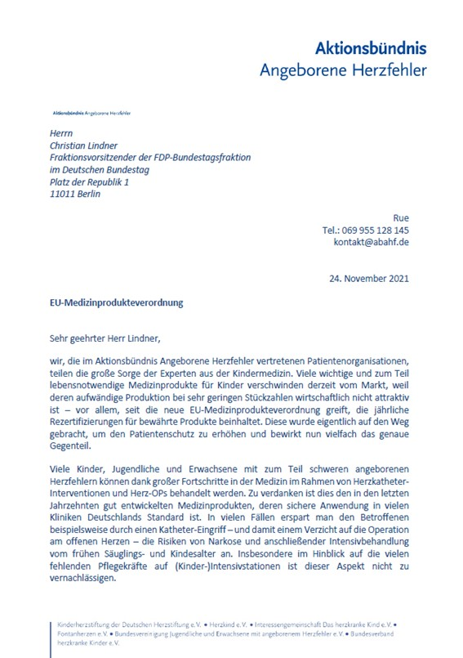
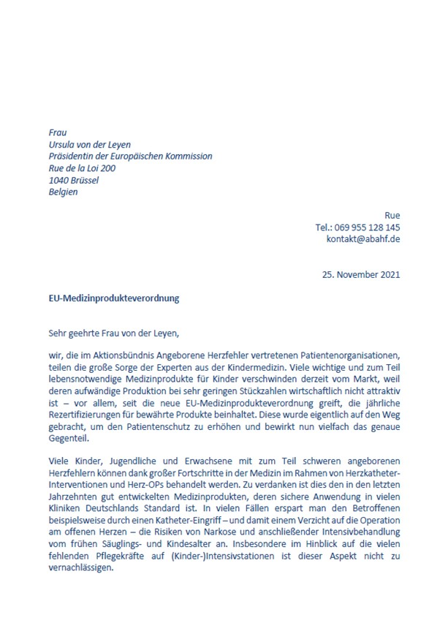
our activities III
2021
Kai Rüenbrink
MEP Heartgroup Meeting 2023

Slide 13
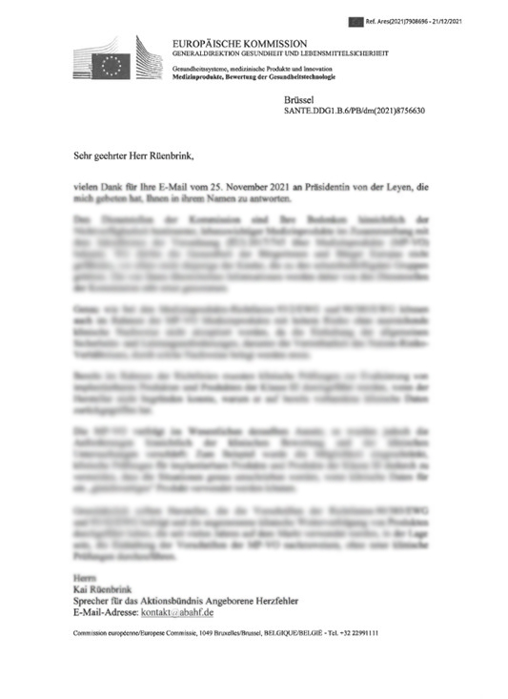
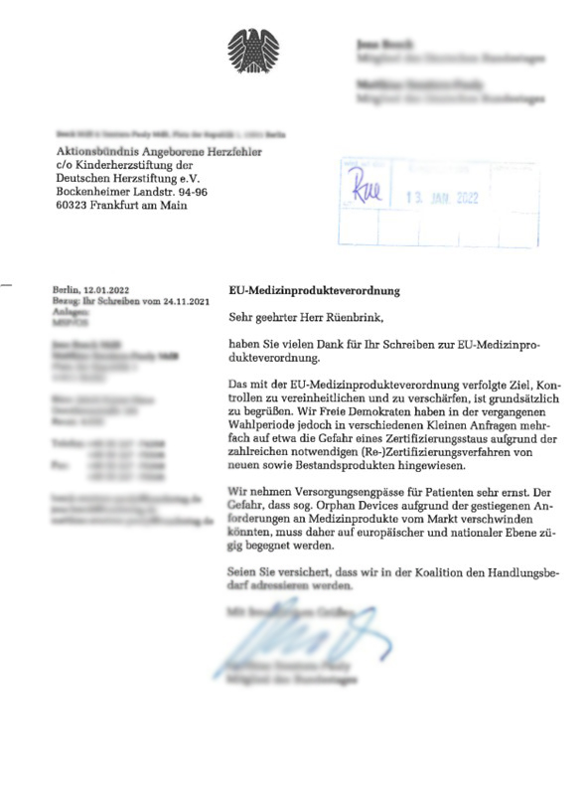
the activities IV
Did we get an answer?
“There may be cases in which the additional requirements of the MP-VO to the
Clinical evaluation procedures and certification by notified bodies
represent a challenge, especially for micro, small and medium-sized manufacturers. This
applies in particular to medical devices for small groups of patients ("orphan" products).”
“We take supply bottlenecks for patients very seriously. Due to the increased requirements, there is a risk that orphan devices could
disappear from the market.
Action must be taken quickly at European and national level.”
“…has the coordination group
medical devices a task force was set up to further assess the situation. We
first of all need to check if it's a temporary problem im
connection with the transition from the guidelines to the MP-VO or a
structural, long-term problem before we can conceive solutions.
In this context, your views, which are in the interests of the patients
and patient represented, of great value.”

Slide 14
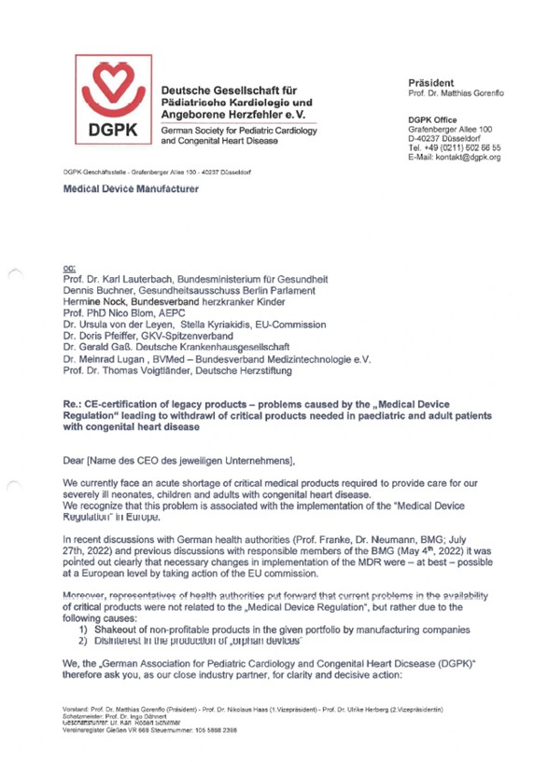
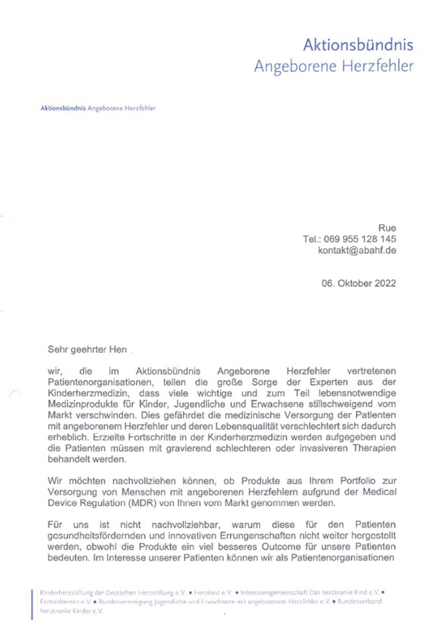
our activities V
MEP Heartgroup Meeting 2023

Slide 15
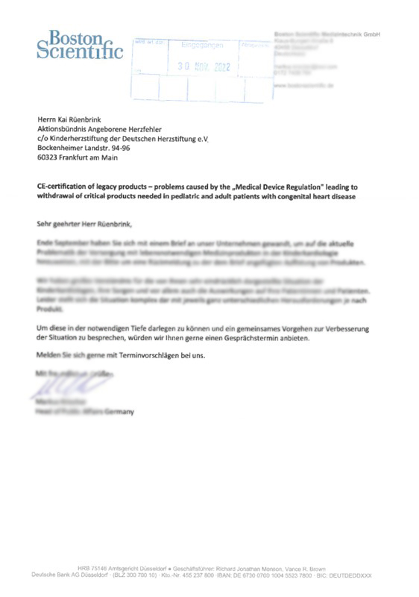
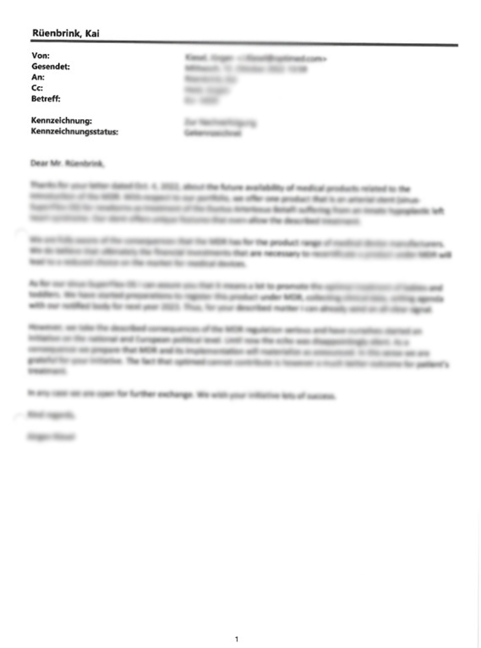
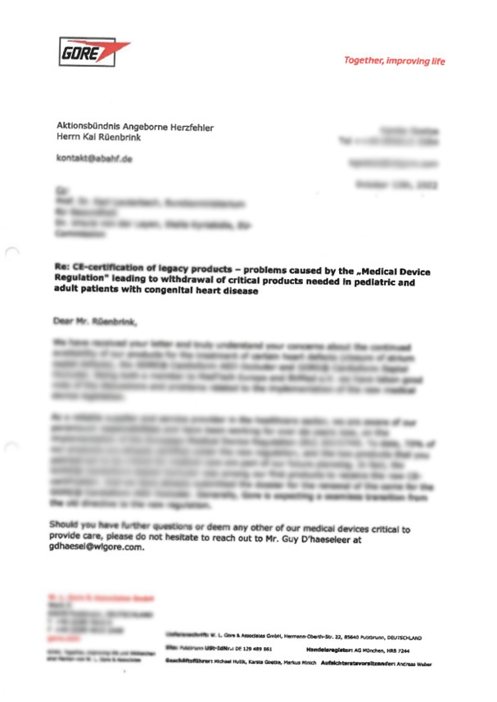
the activities VI
Did we get an answer?
Kai Rüenbrink

Slide 16
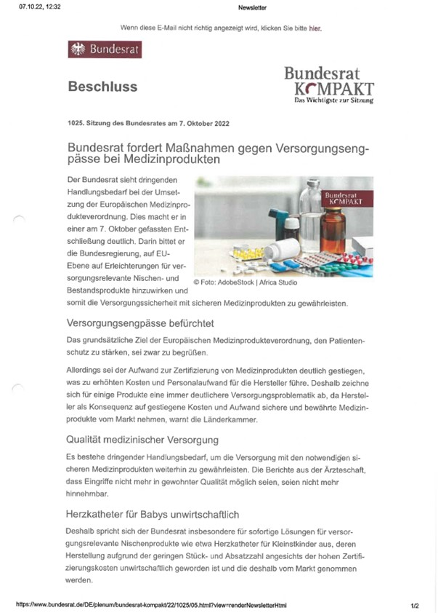
other activities
“Federal Council calls for measures against supply bottlenecks
for medical devices”
Kai Rüenbrink
MEP Heartgroup Meeting 2023

Slide 17
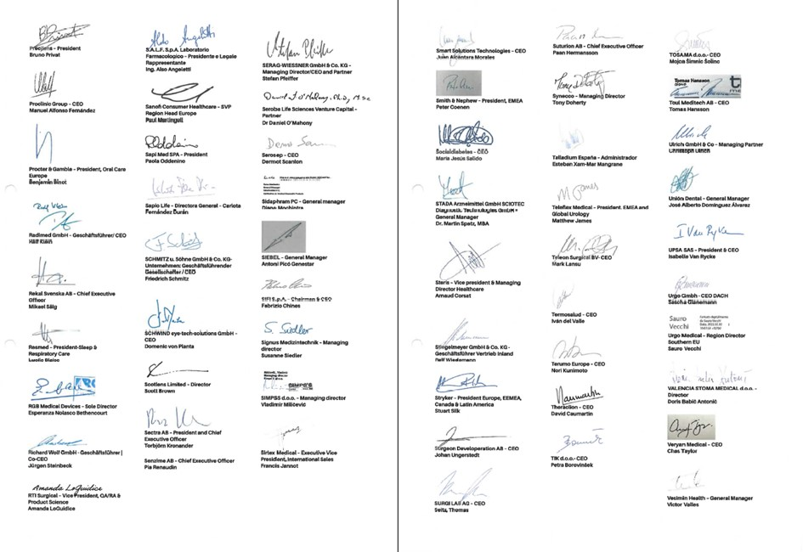
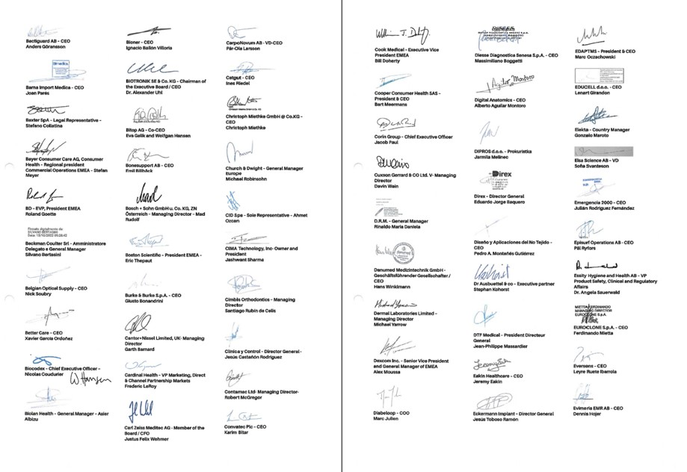
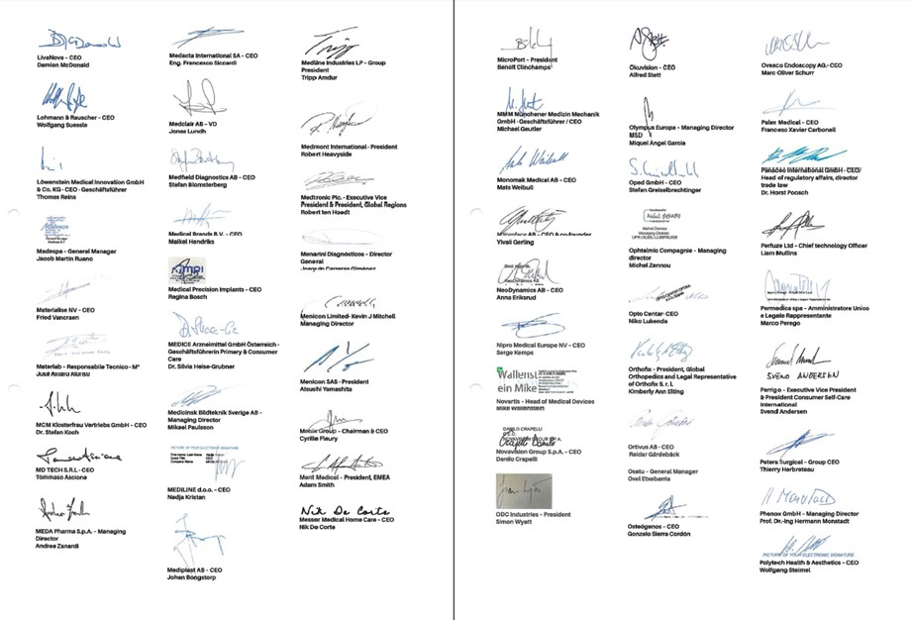
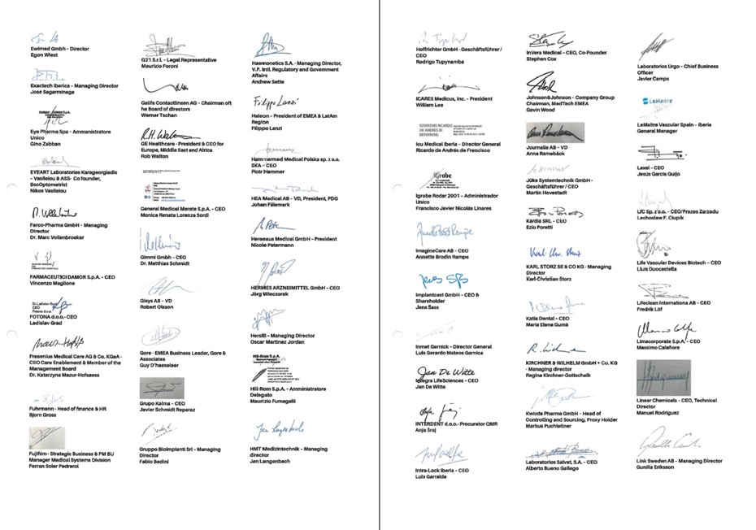
other activities
Letter to Professor Vlastimil Valek, Deputy Prime Minister and Minister of Health
“As industry leaders of the medical technology industry, we would like to reiterate our serious concerns regarding the current implementation status of the Medical Devices Regulation”

Slide 18
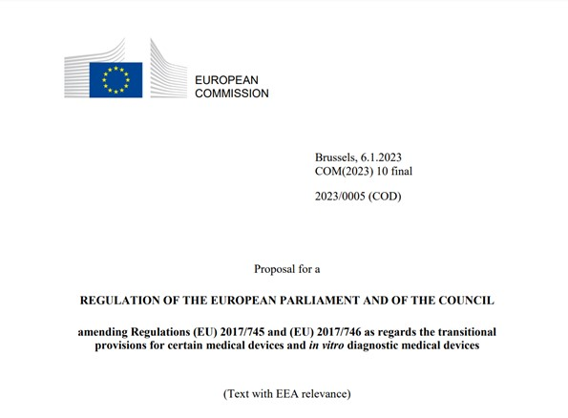
result of all these activities

Slide 19
result of all these activities
“Despite considerable progress over the past years, the overall capacity of conformity assessment (‘notified’) bodies remains insufficient to carry out the tasks required of them…. This is threatening the availability of medical devices on the EU market.”
October 2022:
8,120 applications received from manufacturers for MDR certification
1,990 certificates in accordance with the MDR.
Notified bodies estimate that the transition of all Directives’ certificates to MDR certificates could possibly be completed by December 2027.
Kai Rüenbrink
MEP Heartgroup Meeting 2023

Slide 20
result of all these activities
This is in stark contrast to 21.376 valid certificates issued under Council Directive on active implantable medical devices and Council Directive on medical devices that will expire between January 2023 and
26 May 2024.
4.311 certificates will expire in 2023
and
17.095 certificates will expire in the first five months of 2024.
3.509 certificates issued under the AIMDD or MDD have already expired between May 2021 and December 2022.
Remember:
And once products have disappeared from the market, it is almost impossible to reintroduce them in a timely manner.
Kai Rüenbrink
MEP Heartgroup Meeting 2023

Slide 21
result of all these activities
“The transition period is extended
from 26 May 2024 until 31 December 2027 for higher risk devices
and
until 31 December 2028 for medium and lower risk devices.”
But only under special conditions…
Kai Rüenbrink
MEP Heartgroup Meeting 2023

Slide 22
conclusion
Together with many other players (pediatric cardiologists, medical device manufacturers and patient organizations), we have made great efforts to ensure patient care in the future.
Policymakers have implemented an extension of the deadline.
Experts agree: this alone will not be enough to ensure patient care.
We have gained some time, but we must not let up in our efforts to find a satisfactory solution for patients across Europe.
By the end of the transition period, there will be no sufficient supply of orphan devices. This applies not only to products for children with heart defects, but also to many other patients with rare diseases.
Kai Rüenbrink
MEP Heartgroup Meeting 2023

Slide 23
Thank you
for your attention

