Slide 1
Patients’ perspective
Shortage of Medical Devices in Paediatric cardiology, experience of a father
Prof. Dr. Stefan Hofer; MHBA
Heidelberg

Slide 2
Personal Bias
worries
The best of both Worlds!
Father of 2 girls with WPW-Syndrome
(Cardio)-Anesthesist
Notes:
To be transparent my conflict of interest

Slide 3
Congenital heart defects in Germany
Approximately 9000 children per year with congenital heart defect
90% reach adulthood!
Advances in surgical technique
Advances in interventional pediatric cardiology
Advances in drug therapy
highly complex therapy group

Slide 4
But…
Our ♡-children are in a complex medical fringe group!

Slide 5
Original Idea
MDR
Improvement of Patient Safety

Slide 6
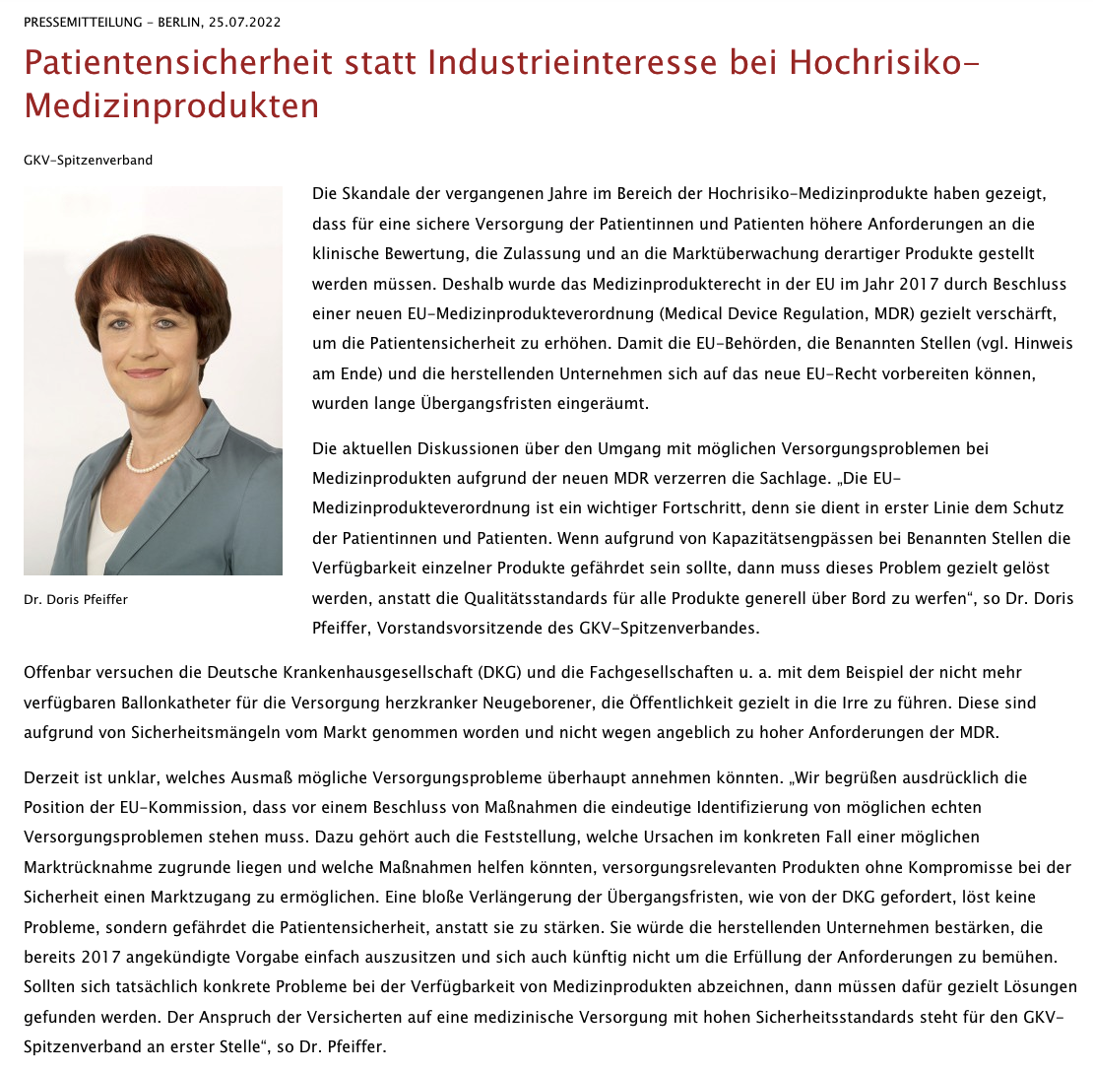
Do we have a stakeholder problem?
„The current discussions about how to deal with possible supply problems with medical devices due to the new MDR distort the situation.“
„Apparently the German Hospital Society (DKG) and the specialist societies are trying to with the example of the no longer available balloon catheters for the care of newborn babies with heart disease, to deliberately mislead the public.“
Of course, we have severe problems!
ttps://www.gkv-spitzenverband.de/gkv_spitzenverband/presse/pressemitteilungen_und_statements/pressemitteilung_1475712.jsp

Slide 7
Parents`fears and real life
MDR
Improvement of Patient Safety
Disturbed chain supply
product streamlining of the companies
political influence of health insurance companies
no problem awareness
confusing market situation
no clear statements

Slide 8
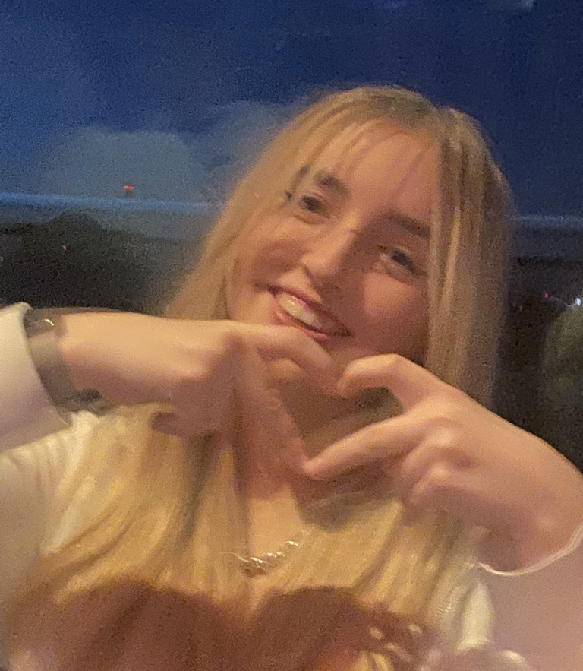
Act now!
The medical industry must show its colors: Are there devices which will be off market?
Based on this results, define possible supply gaps in Europe
Define the must have, to maintain medical european standards !

